Slide 1


Final Submission
Notes:
‹#›

Slide 2

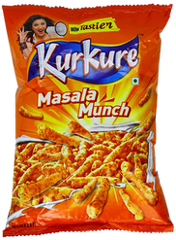
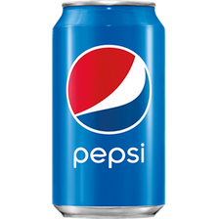
PepsiCo Sales Star Micro-Internship: Market Insights
My Journey in Yavatmal, Maharashtra
Name:
Mrudula Kamdi
College:
Dr.G.Y.Pathikar College of CS &IT
Email Id:
kamdimrudula2003@gmail.com
City:
Yavatmal

Slide 3

Internship Overview: On-Ground Insights
Objective:
To understand how the market is currently operating and gain on-ground insights into field sales dynamics from a shop-level perspective.
Methodology:
Visited 25 diverse retail stores across Yavatmal, Maharashtra.
Collected detailed data on:
PepsiCo Rack Presence
Competitive Landscape
Space Availability for New Racks

Slide 4
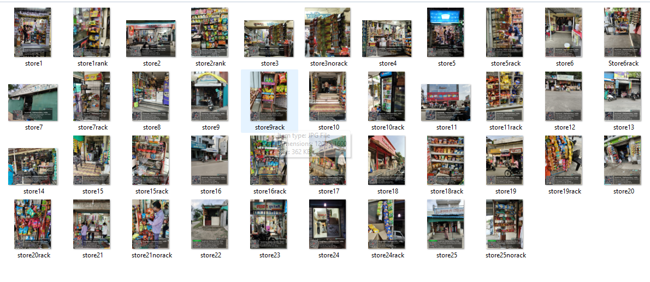
Internship Overview: On-Ground Insights
25 visited store

Slide 5
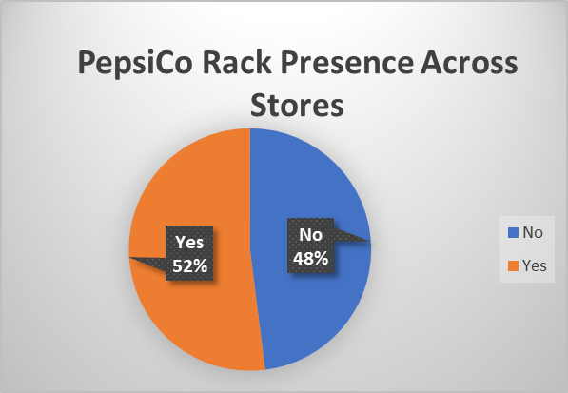
PepsiCo's Footprint: Rack Presence
Overall: 52% of surveyed stores have a PepsiCo rack.
This indicates significant opportunity in the remaining 48% of outlets.

Slide 6
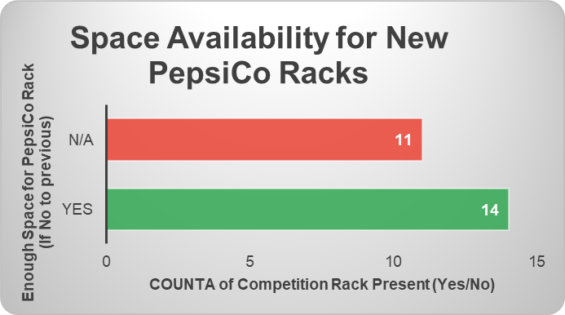
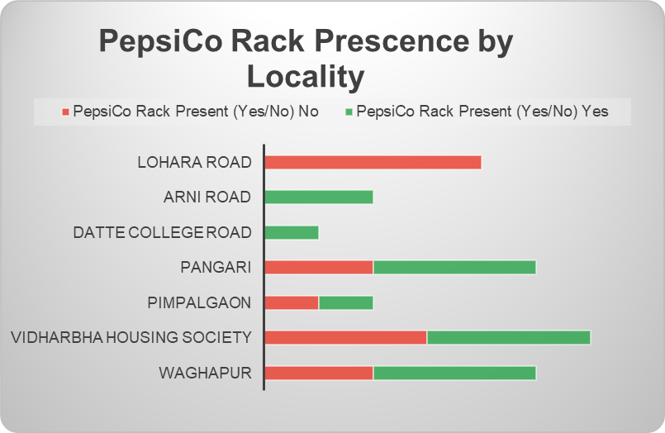
Strategic Growth: Space & Geography
Space for New Racks: Only 1 store without a PepsiCo rack confirmed space.
Crucial Data Gap: Space availability was 'Not Recorded' for 11 other stores lacking a rack – a key area for follow-up!
Locality Variation: Rack presence varies, e.g., high in Arni Road, but no racks observed in Lohara Road.

Slide 7
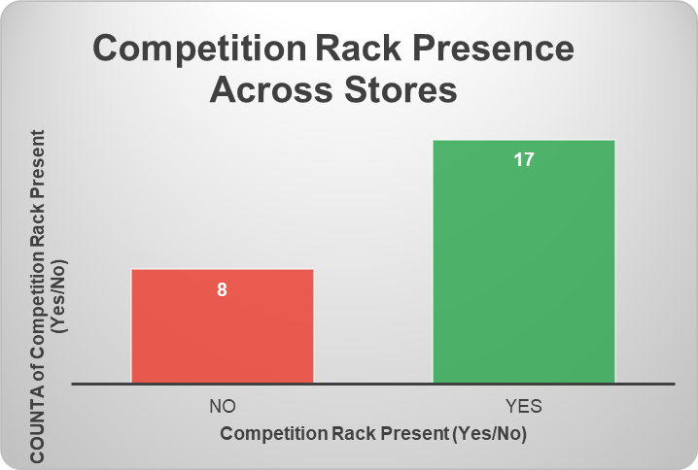
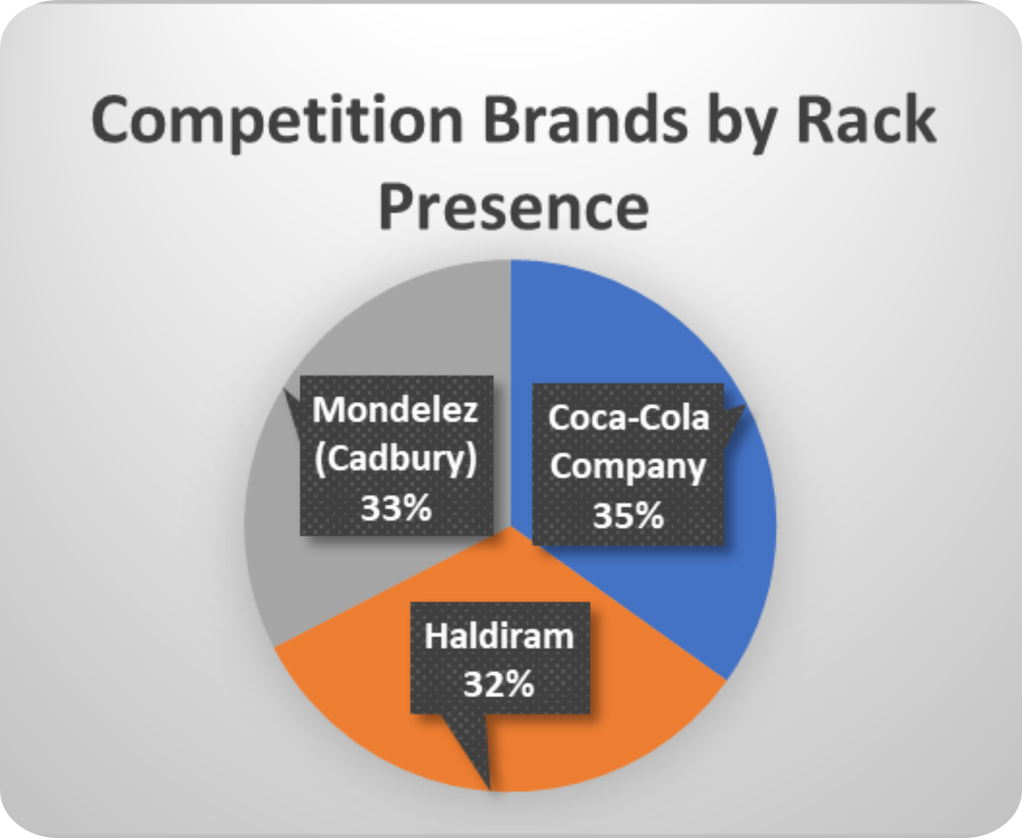
The Competitive Arena
Top Competitors by Rack Presence:
Coca-Cola Company (15 stores)
Mondelez (Cadbury) (14 stores)
Haldiram (14 stores)

Slide 8
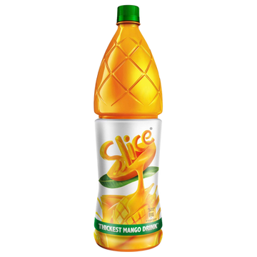

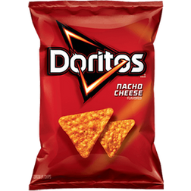
Key Learning and Recommendation
Key Learnings:
Enhanced on-ground data collection & market observation.
Improved basic data analysis skills
Firsthand understanding of retail sales dynamics.
My One Recommendation:
Targeted follow-up at 12 stores without PepsiCo racks to identify exact display space.

Slide 9
THANK YOU !

